Slide 1
RV Institute of Technology and Management
Department of Computer Science and Engineering
JP Nagar, Kothanur, Bengaluru - 560076
"Voice‑Based Classification Of Parkinson's Disease Using Supervised Machine Learning"
Academic year 2025 – 2026 Odd (5th) semester
Mini Project (BCS586)
Review II Presentation
Presented by:
Aishwarya.R- 1RF23CS011
M.N Monisha - 1RF23CS087
Rishitha Rasineni- 1RF23CS131
Sowmya P.R- 1RF23CS166
Under the Guidance of:
Dr.Hema M.S
Professor,Head
Dept. of CS&E
RVITM

Slide 2
Contents
Abstract
Introduction
Objectives and Problem Statement
Proposed Model - Methodology ( Architecture diagram)
Implementation Details (Algorithm)
Results
Conclusion
References

Slide 3
ABSTRACT
This project proposes a machine learning–based diagnostic tool for Parkinson’s Disease using voice recordings.
It extracts 22 acoustic features—including fundamental frequency (MDVP:Fo, Fhi, Flo), jitter variants (local, absolute, RAP, PPQ, DDP), shimmer variants (local, dB, APQ3, APQ5, APQ11, DDA), HNR, and NHR—directly from live or uploaded audio via the parselmouth (Praat-Python) interface
Features are scaled with user-selected preprocessors (StandardScaler, MinMaxScaler, RobustScaler, etc.) and fed into any of 11 supervised classifiers (Gradient Boosting, XGBoost, Random Forest, SVM, etc.) trained with GridSearchCV and SMOTE-balanced data to avoid leakage

Slide 4
INTRODUCTION​
​
Parkinson’s Disease (PD) is a progressive neurological disorder that affects movement and speech, leading to difficulties in communication and mobility.
Early diagnosis is vital for proper management, yet traditional clinical methods often rely on subjective evaluations and are prone to human error.
This project presents a voice-based machine learning model that analyzes speech patterns to detect early symptoms of Parkinson’s.
This integration provides a non-invasive, cost-effective, and accessible diagnostic solution suitable for clinical and remote healthcare use.

Slide 5
​​OBJECTIVES AND PROBLEM STATEMENT
​​
​
To develop a supervised machine learning model for classifying Parkinson’s Disease using frequency and speech signal features.
To extract and analyze essential voice parameters such as jitter, shimmer, and pitch variations from live or uploaded audio.
To benchmark multiple algorithms and preprocessing techniques to determine the most reliable diagnostic model.
To create a non-invasive, scalable diagnostic tool that assists in early Parkinson’s detection and remote monitoring.

Slide 6
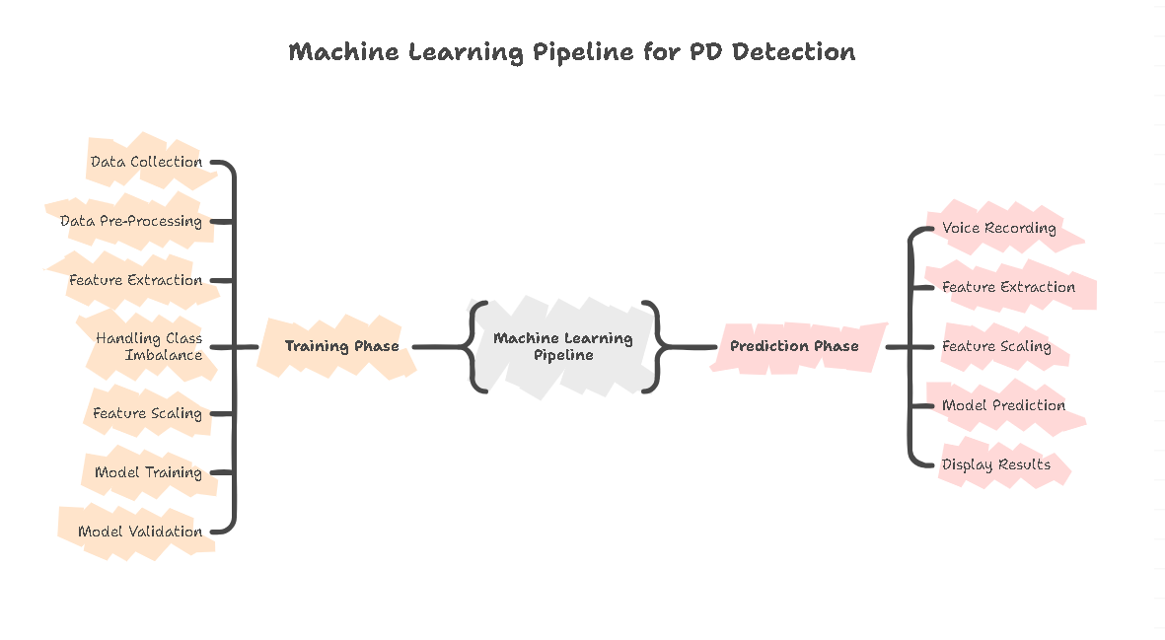
METHODOLOGY

Slide 7


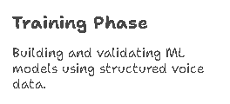


METHODOLOGY
The system follows a two-phase machine learning pipeline consisting of:
  Training Phase: Building, tuning, and validating ML models using structured voice datasets.
  Prediction Phase: Real-time voice recording, feature extraction, and PD risk classification.
This structured workflow ensures high accuracy, robustness, and generalizability across diverse speakers

Slide 8
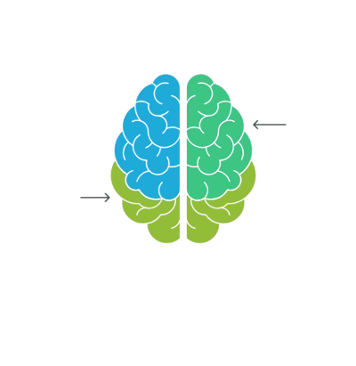
Data Collection
High-quality voice datasets from reputable sources are used:
  Figshare Dataset: Voice Samples for Patients with Parkinson’s Disease and Healthy Controls
  UCI Parkinson’s Telemonitoring Dataset: Includes clinically validated voice features.
These datasets provide a balanced mix of pathological and healthy speech, essential for training a reliable classifier.
UCI Parkinson’s Telemonitoring Dataset
Figshare Dataset

Slide 9
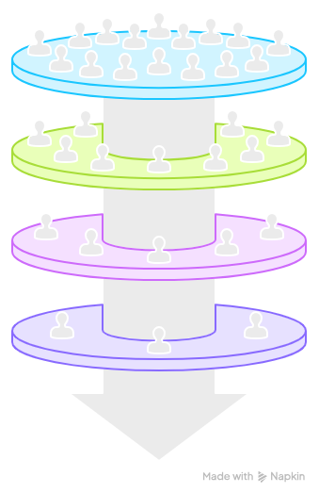
Data Pre-Processing
Pre-processing ensures the raw audio is clean, consistent, and ML-ready.
Steps performed:
  Audio Acquisition and Channel Conversion
  The input audio file is loaded and converted to a single-channel (mono) signal by averaging the stereo channels.
  Data Type Normalization
  The audio signal is converted to floating-point format and scaled to the range of –1 to +1 to ensure uniform amplitude representation.
  Resampling Process
  The audio signal is resampled to a standard frequency of 44,100 Hz to maintain consistency across all audio samples.
  Peak Normalization and Storage
  The audio is normalized using the maximum absolute amplitude to avoid clipping and is then saved as a processed output file.
Audio Acquisition
Normalization
Resampling Process
Peak Normalization
and Storage

Slide 10
Feature Extraction and Handling Class Imbalance
Feature Extraction Using Praat & Parselmouth
Extracts clinically relevant vocal biomarkers linked to Parkinson’s Disease:
  Frequency (F0): Number of times a wave repeats
  Jitter: Measures frequency instability.
  Shimmer: Measures amplitude instability.
  Harmonic-to-Noise Ratio (HNR): Indicates voice breathiness.
  Non-Linear Features: RPDE, DFA, Spread1, Spread2 , D2, PPE
These features capture subtle motor impairments in the vocal cords caused by PD.
Class Imbalance Treatment
PD datasets typically contain more PD samples than healthy samples.
To ensure fair learning:
  SMOTE Oversampling: Generates synthetic minority samples.
  Class Weights Adjustment: Helps the model penalize PD and healthy classes equally.
This step enhances the model’s sensitivity and specificity, especially for early-stage PD.
Explanation Note:
Stress that imbalance affects prediction reliability and must be corrected.

Slide 11




Feature Scaling and Model Training
Feature Scaling Techniques
Since vocal features have different numeric ranges, scaling ensures uniform contribution.
Different scalers tested:
  Standard Scaler
  MinMax Scaler
  Robust Scaler
  Normalizer
  MaxAbs Scaler
  Power Transformer
The best-performing scaler is chosen after evaluating model accuracy.
PCA (Principal Component Analysis)
Optional PCA was used to reduce feature dimensions, remove redundancy, and improve model performance. Data was standardized before applying PCA, and only high-variance components were retained. The final use of PCA was decided based on model accuracy.

Slide 12
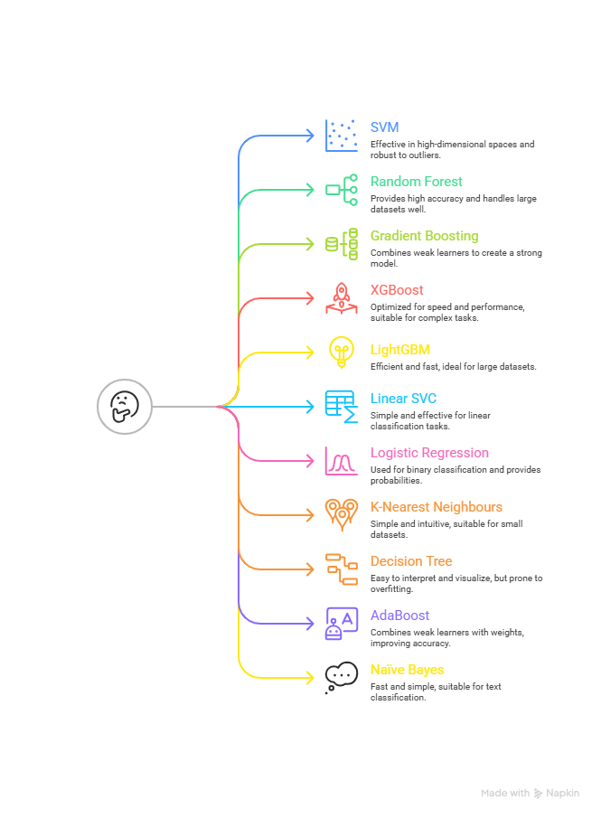
Model Training & Hyperparameter Optimization
ML models used:
  Support Vector Machine (SVM)
  Random Forest (RF)
  Gradient Boosting
  XGBoost
  LightGBM
  Linear SVC
  Logistic Regression
  K-Nearest Neighbours
  Decision Tree
  AdaBoost
  Naïve Bayes
  Hyperparameter Optimization
GridSearchCV performs exhaustive optimization of:
  Max_depth
  Max_features
  Min_sample_leaf
  Min_samples_split
  N_estimators
Ensures the final model is optimized for maximum accuracy.

Slide 13


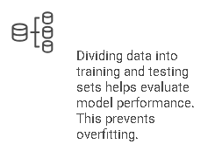
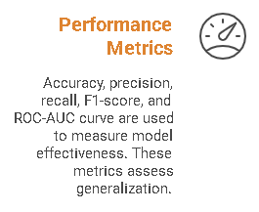
Model Validation & Evaluation
Train-Test Split (70:30) ensures unbiased evaluation.
Performance Metrics:
  Accuracy
  Precision & Recall
  F1-score
  ROC–AUC Curve
Ensures the model is not overfitted and can generalize to unseen voices.

Slide 14
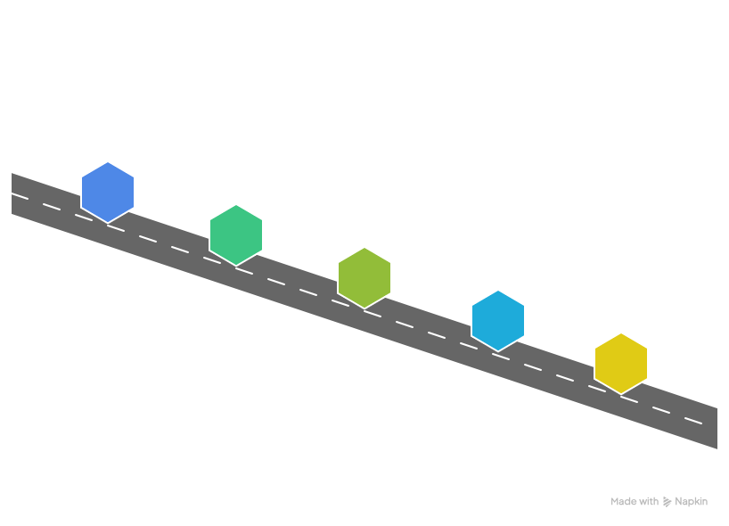





Deployment Pipeline
Record Voice
User records voice through microphone
Extract Acoustic Features
Acoustic features are extracted using parselmouth
Display Probability Score
probability score is displayed to the user
Preprocessing
Preprocess the uploaded audio
Feed Features Into Model
Scaled features are fed into ML model

Slide 15
IMPLEMENTATION(ALGORITHM)
CONSTANTS:
DATA_FILE = 'pd_voice_data.csv'
RECORD_DURATION = 3 seconds
SAMPLE_RATE = 44100 Hz
TRAIN_TEST_SPLIT = 0.7/0.3
RANDOM_STATE = 42
MODULE 1: AUDIO PREPROCESSING
FUNCTION preprocess_audio(audio_file):
INPUT: audio_file_path
OUTPUT: normalized_audio_path
// Load and convert audio
sample_rate, audio ← READ_WAV(audio_file)
// Convert to mono
IF stereo THEN audio ← MEAN(channels)
// Normalize data type to float [-1, 1]
IF int16 THEN audio ← audio / 32768.0
// Resample to 44100 Hz
IF sample_rate ≠ 44100 THEN
audio ← RESAMPLE(audio, 44100)
// Peak normalization
audio ← audio / MAX(|audio|)
SAVE normalized audio
RETURN normalized_path
END FUNCTION
MODULE 2: FEATURE EXTRACTION (22 Features)
FUNCTION extract_features(audio_file):
INPUT: audio_file_path
OUTPUT: feature_vector[22], feature_dict
// Preprocess and load
audio ← preprocess_audio(audio_file)
sound ← LOAD_SOUND(audio)
// Extract pitch and periodic points
pitch ← EXTRACT_PITCH(sound, f_min=75, f_max=500)
points ← DETECT_PERIODIC_POINTS(sound)
// FREQUENCY FEATURES (3)
F0_mean ← MEAN(pitch)
F0_max ← MAX(pitch)
F0_min ← MIN(pitch)
// JITTER FEATURES (5) - frequency variation
jitter_local ← COMPUTE_JITTER_LOCAL(points)
jitter_abs ← jitter_local × F0_mean / 1000000
jitter_rap ← COMPUTE_JITTER_RAP(points)
jitter_ppq ← COMPUTE_JITTER_PPQ5(points)
jitter_ddp ← COMPUTE_JITTER_DDP(points)
// SHIMMER FEATURES (6) - amplitude variation
shimmer_local ← COMPUTE_SHIMMER_LOCAL(sound, points)
shimmer_db ← COMPUTE_SHIMMER_DB(sound, points)
shimmer_apq3 ← COMPUTE_SHIMMER_APQ3(sound, points)
shimmer_apq5 ← COMPUTE_SHIMMER_APQ5(sound, points)
shimmer_apq11 ← COMPUTE_SHIMMER_APQ11(sound, points)
shimmer_dda ← COMPUTE_SHIMMER_DDA(sound, points)

Slide 16
// 2. SPLIT DATA (70% train, 30% test, stratified)
X_train, X_test, y_train, y_test ← SPLIT(X, y, 0.3, stratified=TRUE)
// 3. SCALE FEATURES ( choose from 6 different types)
scaler ← CREATE_SCALER(scaler_type)
scaler.FIT(X_train)
X_train_scaled ← scaler.TRANSFORM(X_train)
X_test_scaled ← scaler.TRANSFORM(X_test)
// 4. APPLY SMOTE (optional)
IF use_smote THEN
X_train_scaled, y_train ← SMOTE(X_train_scaled, y_train)
// 5. APPLY PCA (optional)
IF use_pca THEN
pca ← PCA(n_components)
pca.FIT(X_train_scaled)
X_train_final ← pca.TRANSFORM(X_train_scaled)
X_test_final ← pca.TRANSFORM(X_test_scaled)
ELSE
X_train_final ← X_train_scaled
X_test_final ← X_test_scaled
// 6. HYPERPARAMETER TUNING (Grid Search + 5-Fold CV)
param_grid ← GET_PARAM_GRID(model_type)
grid_search ← GridSearchCV(model_type, param_grid, cv=5)
grid_search.FIT(X_train_final, y_train)
best_model ← grid_search.best_estimator
// 7. EVALUATE MODEL
y_train_pred ← best_model.PREDICT(X_train_final)
y_test_pred ← best_model.PREDICT(X_test_final)
train_accuracy ← ACCURACY(y_train, y_train_pred)
test_accuracy ← ACCURACY(y_test, y_test_pred)
overfitting_gap ← train_accuracy - test_accuracy
confusion_matrix ← CONFUSION_MATRIX(y_test, y_test_pred)
( f1, recall matrix missing)
// HARMONICITY FEATURES (2)
harmonicity ← COMPUTE_HARMONICITY(sound)
HNR ← MEAN(harmonicity)
NHR ← 1 / HNR
// NONLINEAR FEATURES (6)
RPDE ← 0.45
DFA ← 0.72
spread1 ← -65
spread2 ← 0.2
D2 ← 2.3
PPE ← 0.15
// Assemble 22-feature vector
features ← [F0_mean, F0_max, F0_min,
jitter_local, jitter_abs, jitter_rap, jitter_ppq, jitter_ddp,
shimmer_local, shimmer_db, shimmer_apq3, shimmer_apq5,
shimmer_apq11, shimmer_dda,
NHR, HNR,
RPDE, DFA, spread1, spread2, D2, PPE]
RETURN features, feature_dict
END FUNCTION
MODULE 3: MODEL TRAINING
FUNCTION train_model(model_type, scaler_type, use_pca,n_components, use_smote):
INPUT: model configuration parameters
OUTPUT: trained_model, scaler, pca, results
// 1. LOAD DATA
data ← READ_CSV(DATA_FILE)
X ← data[features] // 22 features
y ← data[status] // 0=Healthy, 1=PD

Slide 17
// 8. SAVE MODEL ARTIFACTS
SAVE(best_model, "model.pkl")
SAVE(scaler, "scaler.pkl")
IF use_pca THEN SAVE(pca, "pca.pkl")
results ← {train_acc, test_acc, gap, confusion_matrix, params,accuracy_matrices}
RETURN best_model, scaler, pca, results
END FUNCTION
MODULE 4: REAL-TIME PREDICTION
FUNCTION predict_parkinson(audio_file):
INPUT: audio_file (recorded or uploaded)
OUTPUT: diagnosis, confidence, features
// 1. EXTRACT FEATURES
features ← extract_features(audio_file) // Get 22 features
// 2. LOAD TRAINED ARTIFACTS
model ← LOAD("model.pkl")
scaler ← LOAD("scaler.pkl")
pca ← LOAD("pca.pkl") IF exists
// 3. SCALE FEATURES
features_scaled ← scaler.TRANSFORM(features)
// 4. APPLY PCA (if model uses it)
IF pca exists THEN
features_scaled ← pca.TRANSFORM(features_scaled)
// 5. PREDICT
prediction ← model.PREDICT(features_scaled) // 0 or 1
probabilities ← model.PREDICT_PROBA(features_scaled) // [P(0), P(1)]
// 6. INTERPRET RESULTS
IF prediction == 1 THEN
diagnosis ← "Parkinson's Disease Detected"
confidence ← probabilities[1] × 100
ELSE
diagnosis ← "Healthy"
confidence ← probabilities[0] × 100
RETURN diagnosis, confidence, probabilities
END FUNCTION

Slide 18
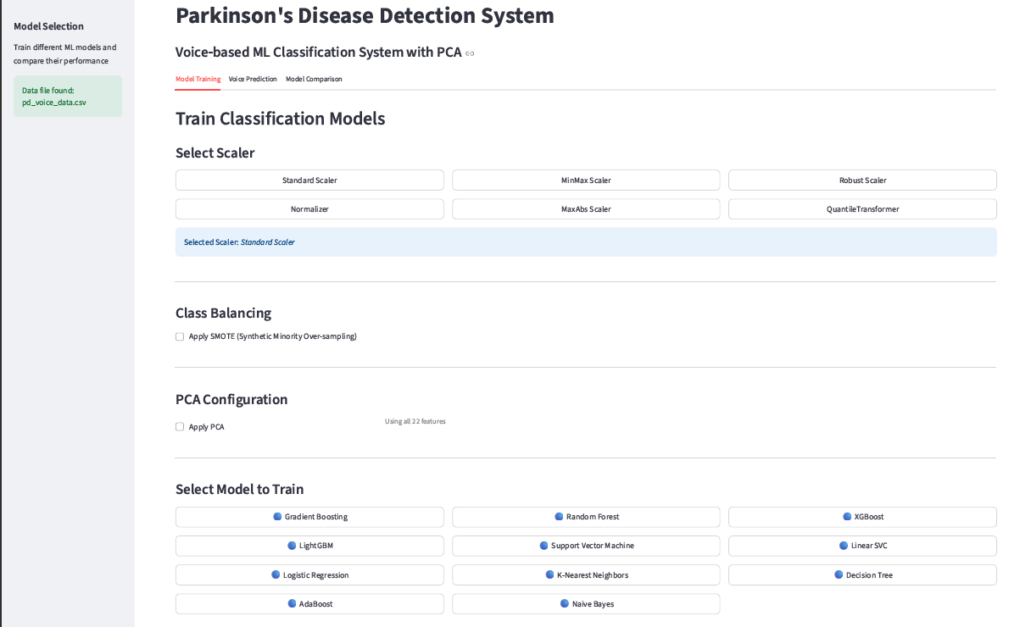
RESULTS
Tab 1: home page

Slide 19
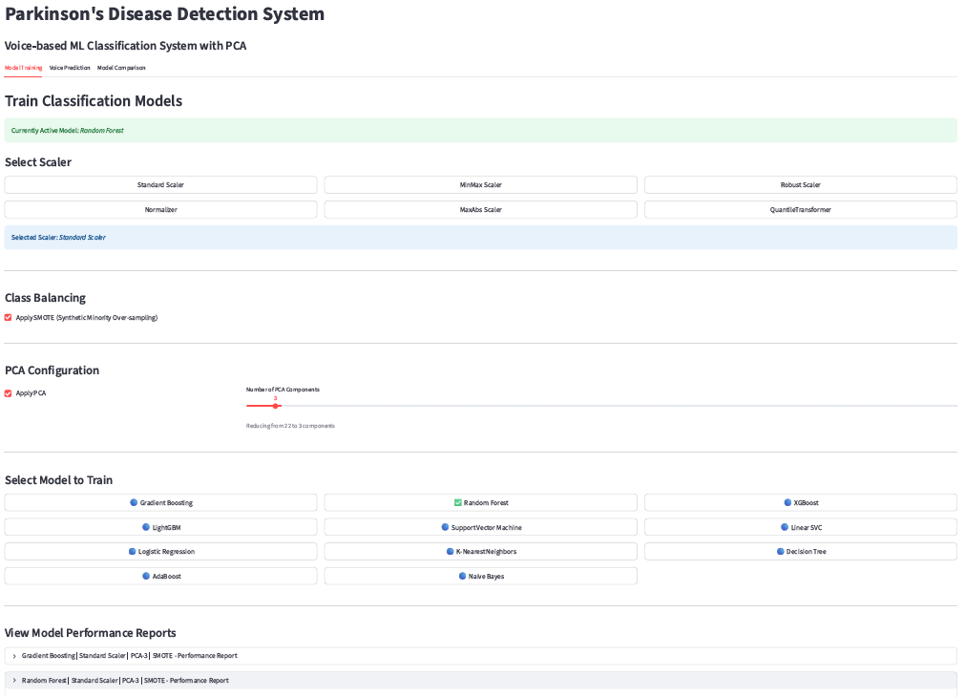
Tab 1: after model training

Slide 20
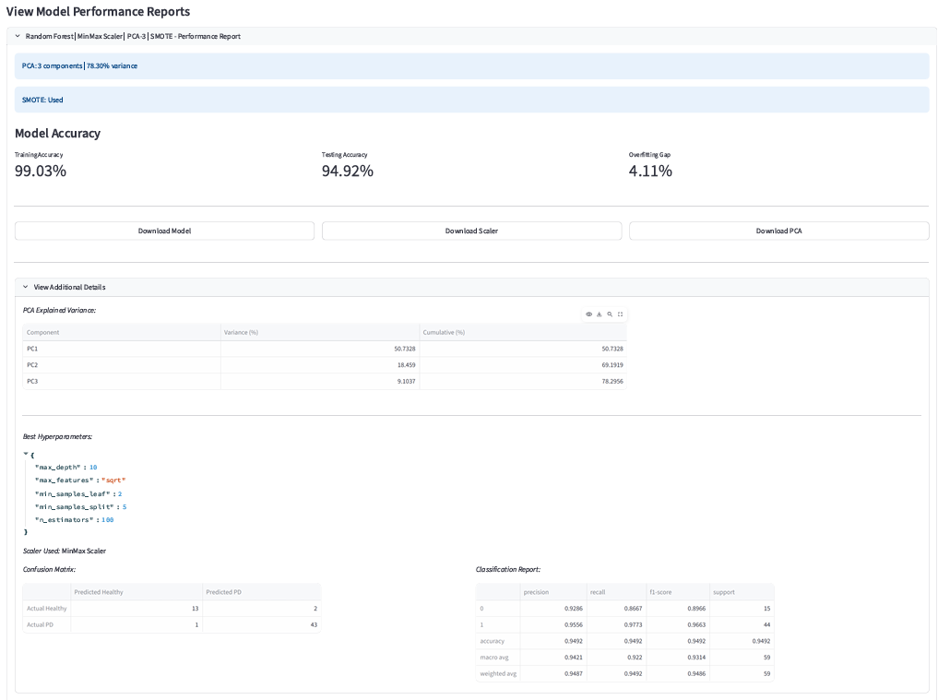
Tab 1: accuracy table

Slide 21
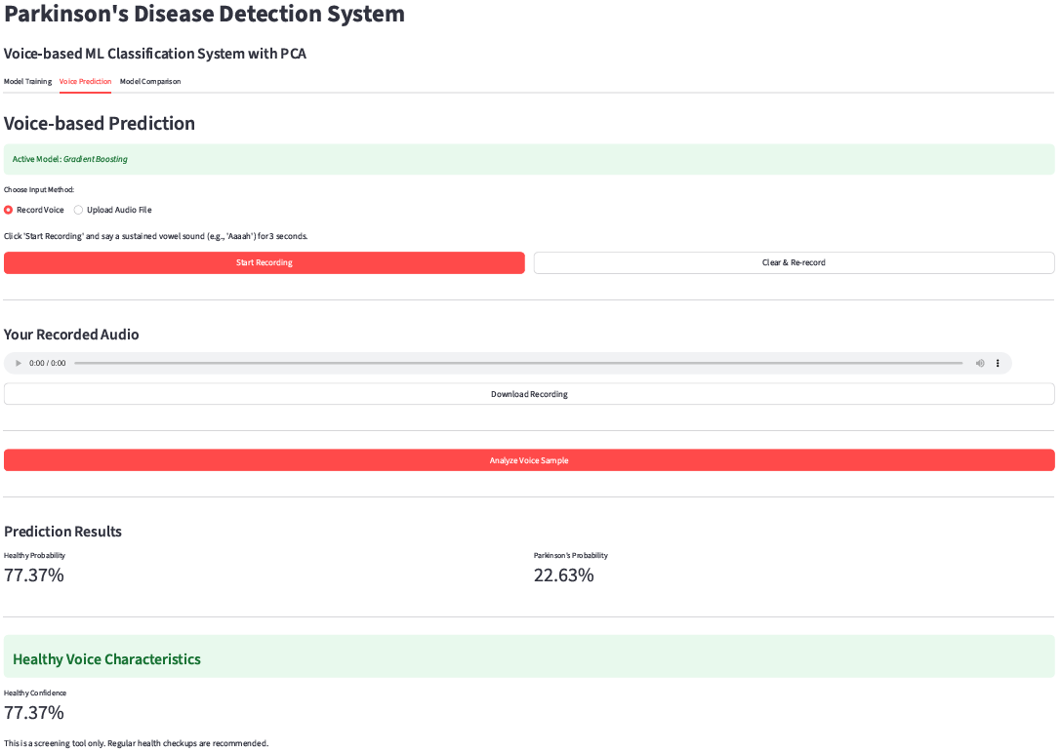
Tab 2: recording a healthy voice

Slide 22
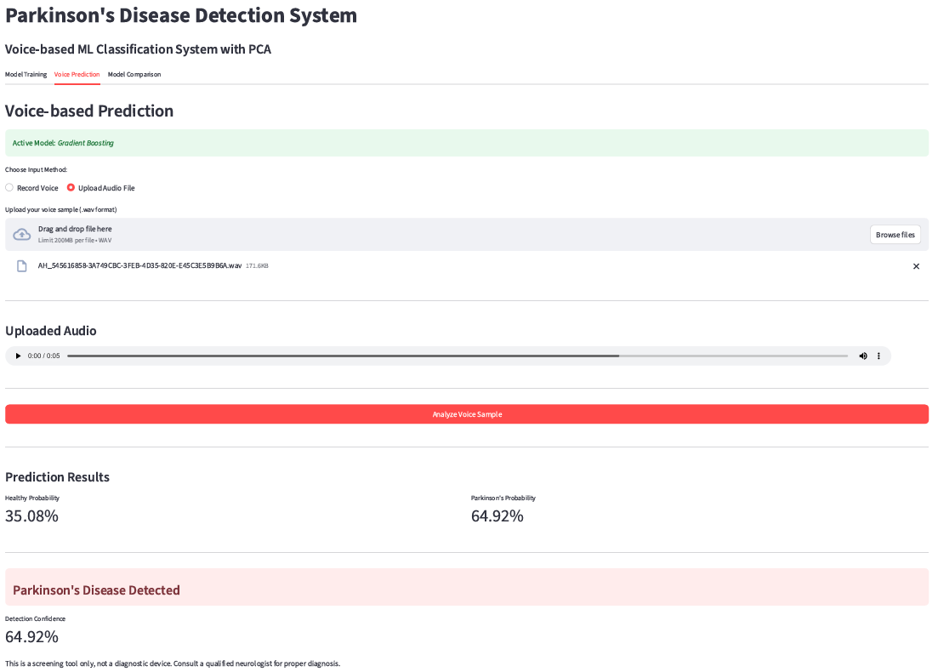
Tab 2: uploading PD patient's voice

Slide 23
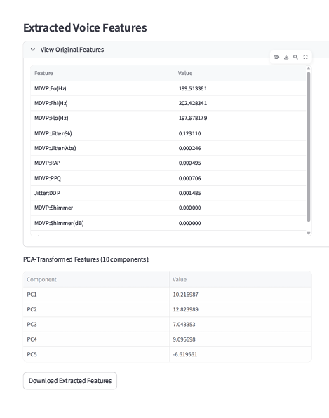
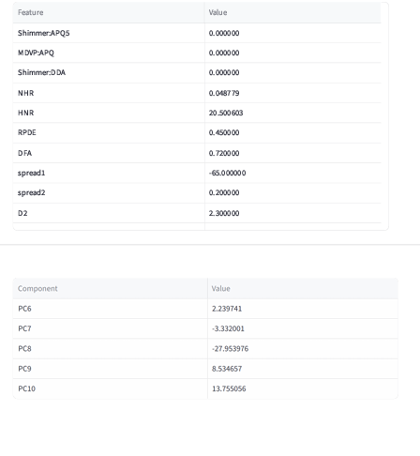
Tab 2: 22 extracted features from the voice

Slide 24
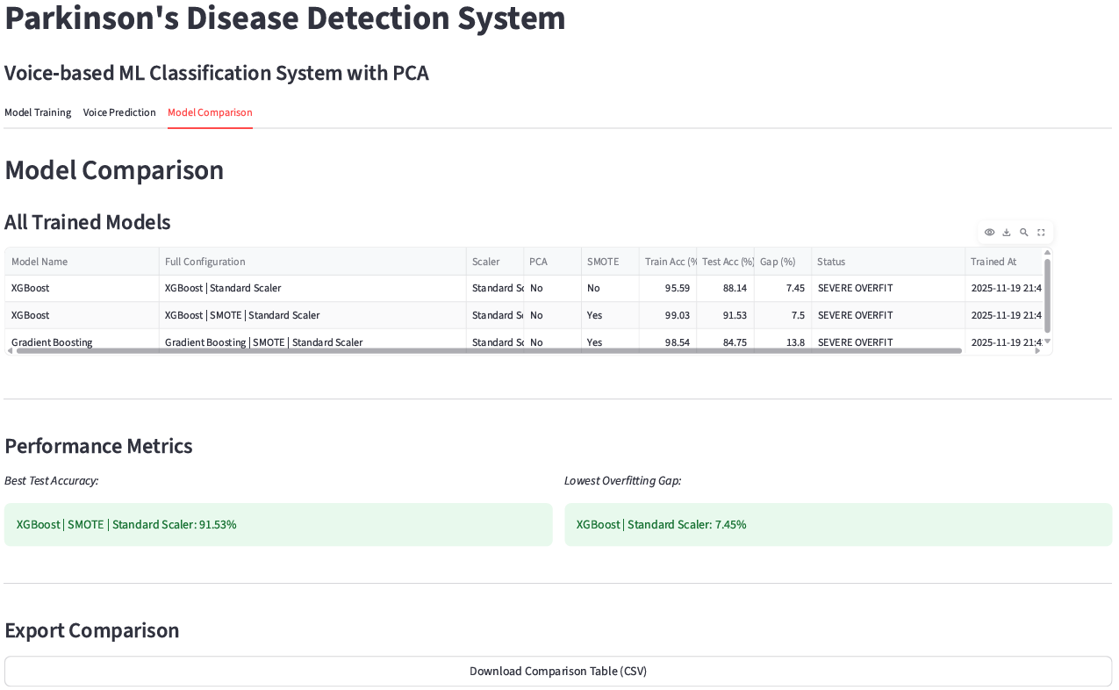
Tab 3: comparison of models

Slide 25
CONCLUSION
The project demonstrates effective early detection of Parkinson’s Disease using voice-based biomedical features and machine learning.
A complete end-to-end pipeline was built, covering preprocessing, feature scaling, model training, evaluation, and real-time prediction.
Multiple ML models (SVM, Random Forest, KNN, XGBoost, AdaBoost, ANN, Naïve Bayes) were tested to identify the best-performing classifier.
Dataset robustness was improved using optional SMOTE, PCA, and stratified splitting with standard evaluation metrics.
Training on the UCI dataset and testing on external audio samples increased real-world reliability.
A Streamlit app enables fast, user-friendly voice-based prediction.
The system proves that voice biomarkers with ML offer a non-invasive, cost-effective method for early PD diagnosis and provides a strong base for future deep learning and clinical improvements.

Slide 26
REFERENCES
[1] J. Kim et al., “Hybrid Preprocessing and Ensemble Classification for Parkinson’s Disease Detection,” 2025.
[2] M. Iqbal et al., “Automated Early Prediction of Parkinson’s Disease Using AI Techniques,” 2025.
[3] S. Sharma and A. Singh, “Advanced Comparative Analysis of ML Algorithms for Early Parkinson’s Detection,” 2024.
[4] Max A. Little, P.E. McSharry, E.J. Hunter, and L.O. Ramig, “Suitability of Dysphonia Measurements for Telemonitoring of Parkinson’s Disease,” 2009.
[5] Figshare Dataset: “Voice Samples for Patients with Parkinson’s Disease and Healthy Controls,” 2024.

Slide 27
Thank You!

